Slide 1
Image Scraping
and
Classification Project
Submitted by:
Ruchi Tiwari

Slide 2
Imported all these Libraries
from selenium import webdriver
from webdriver_manager.chrome import ChromeDriverManager
from bs4 import BeautifulSoup
import pandas as pd
driver = webdriver.Chrome(ChromeDriverManager().install())
import shutil
import requests

Slide 3
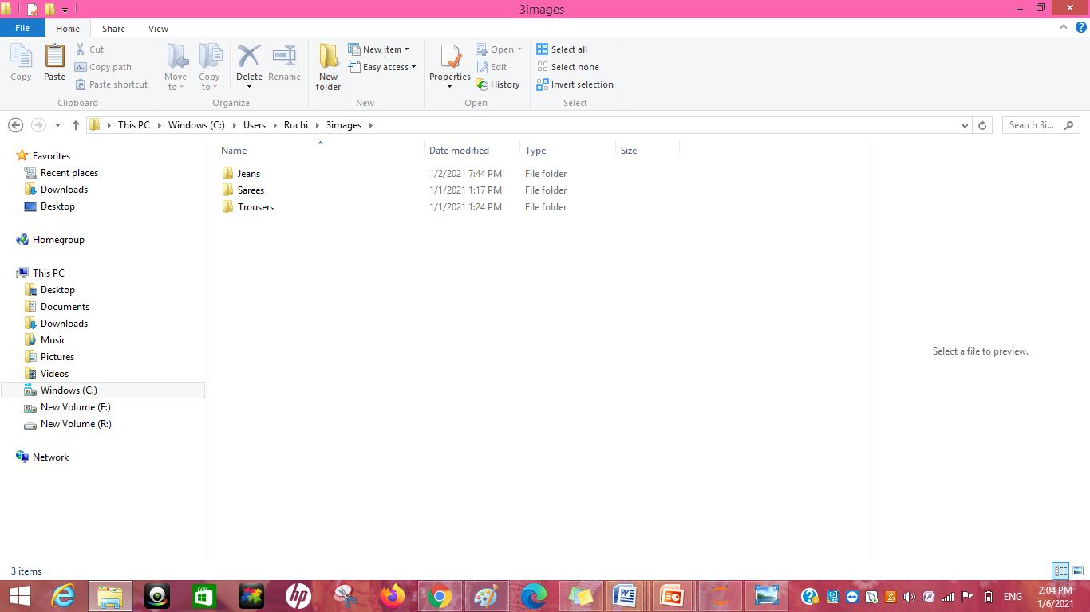
Make Directories to store Images
3 Directories
Sarees
Jeans
Trousers

Slide 4
Import Libraries for deep learning.
import pandas as pd
import numpy as np
import os
import tensorflow as tf
import cv2
from tensorflow import keras
from tensorflow.keras.models import Sequential, Model
from matplotlib import pyplot as plt
import matplotlib.image as mpimg
%matplotlib inline
import random

Slide 5
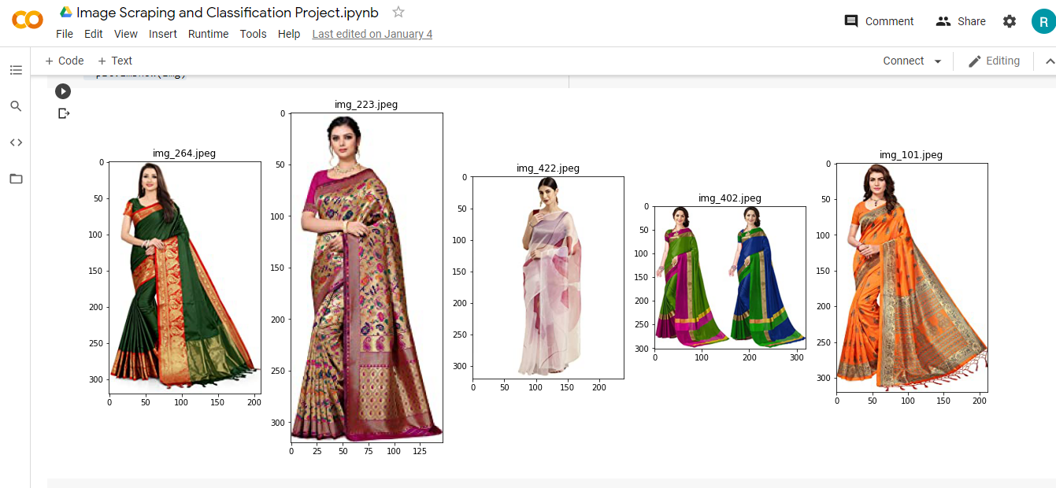
By passing the path of the directory we will get these images.

Slide 6
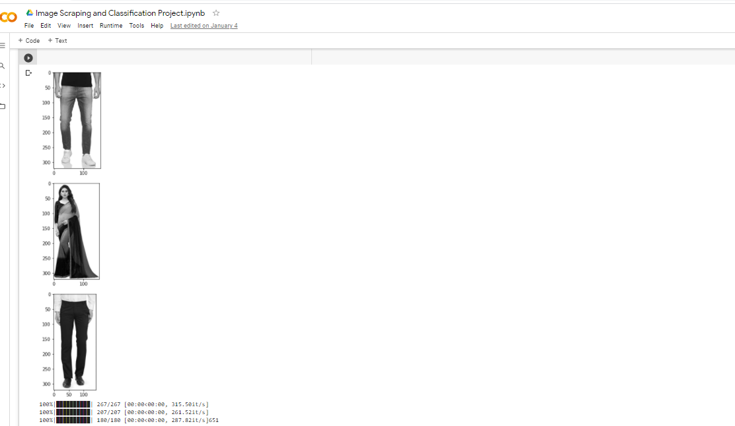
By Passing the Directory path and categories we will get the images of these.

Slide 7
Import the libraries for model building.
import tensorflow as tf
from tensorflow.keras.preprocessing.image import ImageDataGenerator
from tensorflow.keras.models import Sequential
from tensorflow.keras.layers import Dense, Dropout, Activation, Flatten
from tensorflow.keras.layers import Conv2D, MaxPooling2D
from tensorflow.keras.callbacks import TensorBoard

Slide 8
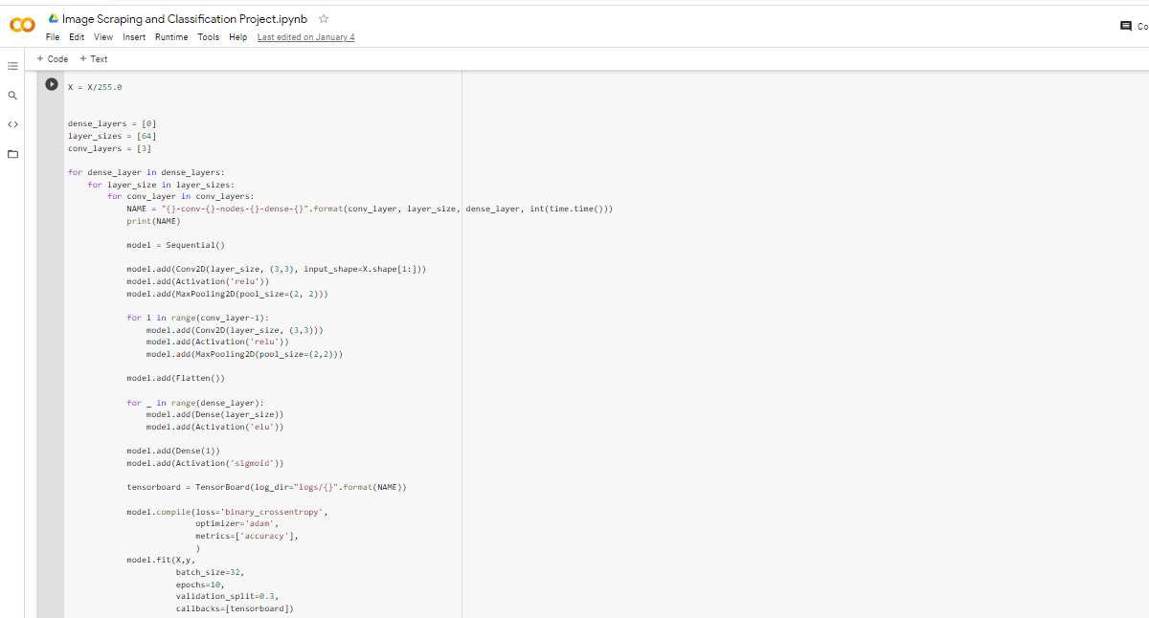
The Below code will help us to get the desired result:-

Slide 9
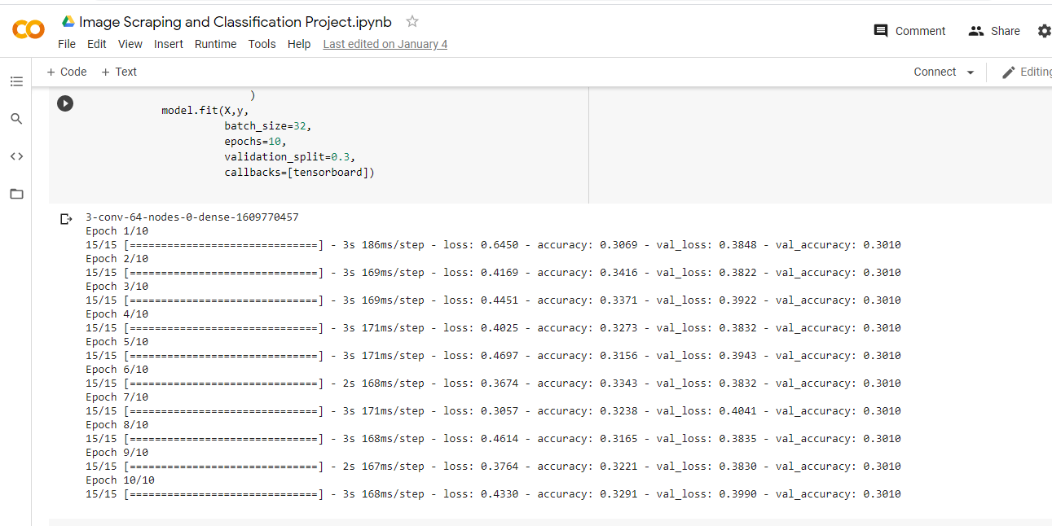
By the help of previous page code we will get the accuracy of the model.

